Slide 1
DDR – Tuning and Calibration
Zhengjianqiang

Slide 2
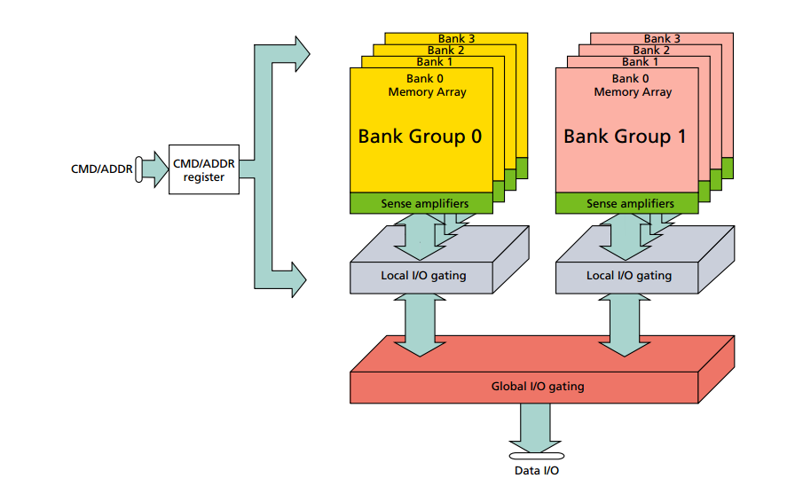
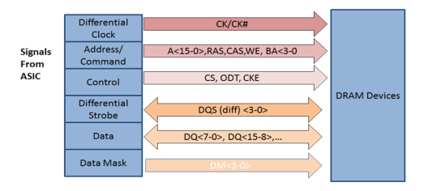
DDR Interface
Interface lines:
Internal bus
2. Address and Command lines
3. Data Strobe and Data lines

Slide 3
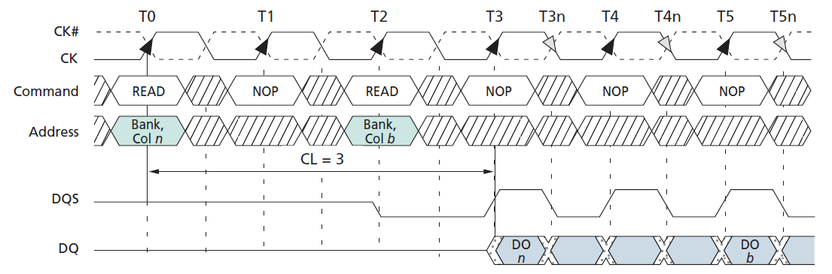
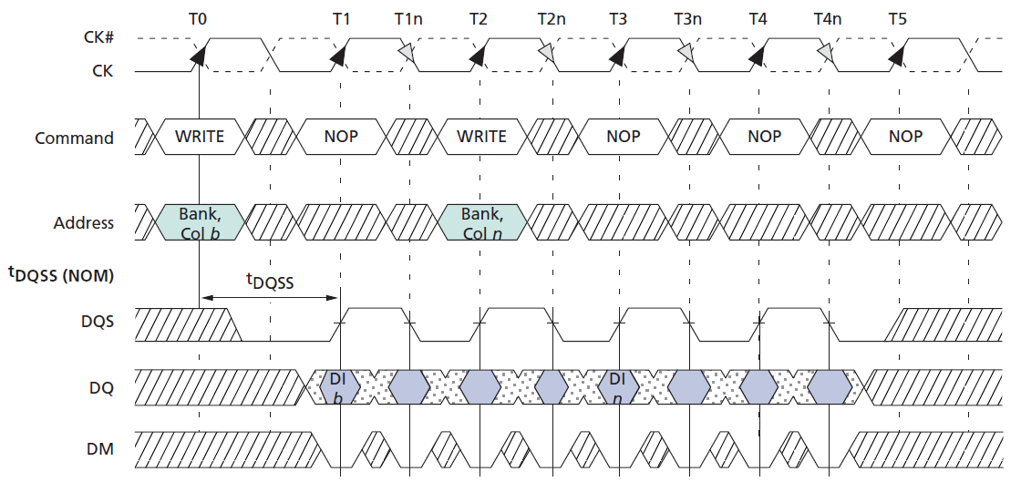
DDR Interface

Slide 4
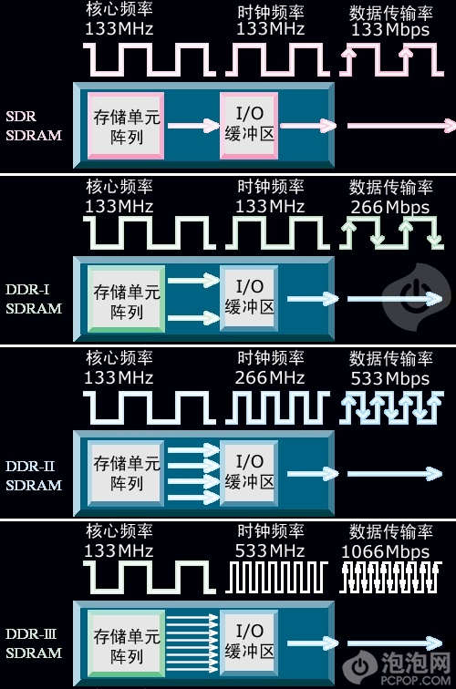
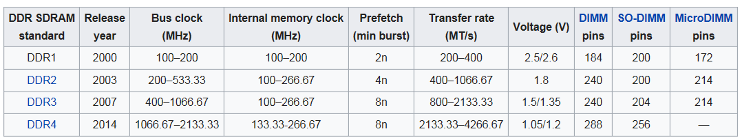
DDR Interface
The operation speed is very hard to improve because of the internal structure of DRAM。
Only speed up the bus clock.
By Prefetch method, the transfer rate can up to 4.2GT/s.

Slide 5
DDR signal integrity
As the bus speed increases, signal integrity should be considered when board design
signal electrical
Cross talk
ISI
Reflection
SSO
Timing
Skew
Vref noise

Slide 6
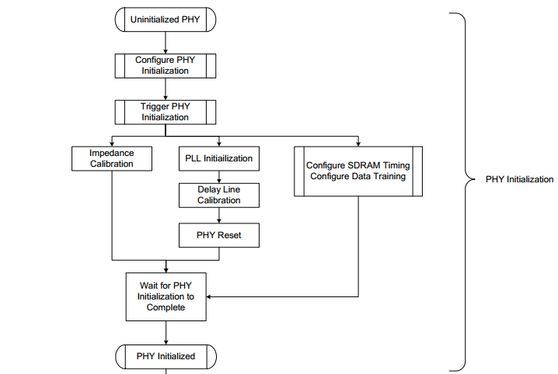
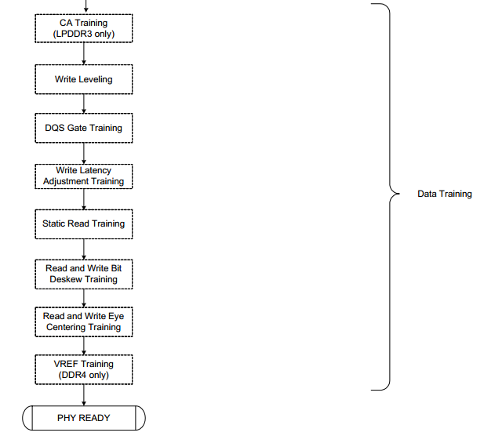
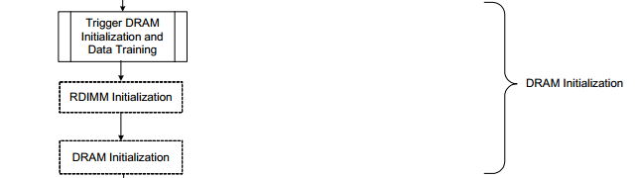
DDR training

Slide 7
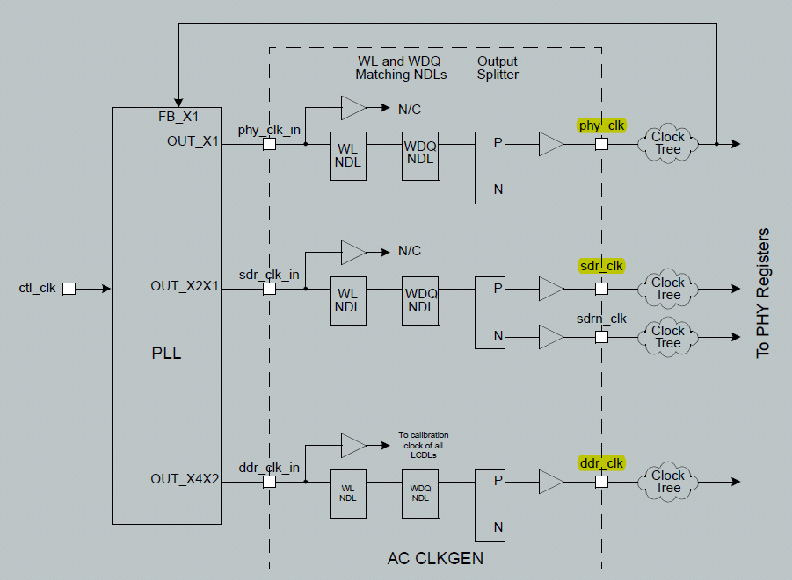
PHY initialization
PLL init

Slide 8
PHY initialization
Delay line calibration
This is done by measuring the number of delay line steps that are required to produce a delay equal to the DDR clock period.

Slide 9
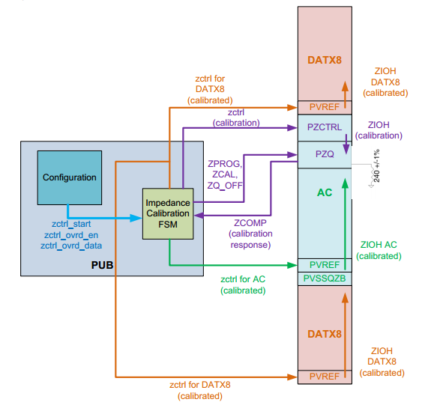
PHY initialization
Impedance Calibration

Slide 10
DRAM initialization
Start power-up sequence by writing POWCTL.power_up_start = 1. Monitor power-up status polling POWSTAT.power_up_done = 1
Write AC timing parameters to PCTL registers. Like tCL, tRCD, tRP, tRAS, etc.
Issue a load Mode Register command to Memory chips by BA1,BA0,A12~A0 signals .
MR2→MR3→MR1→MR0→ZQ calibration at DDR chip side
Wait 512 SDRAM clock cycles for the DLL to lock (tDLLK) and ZQ calibration (tZQinit) to finish.

Slide 11
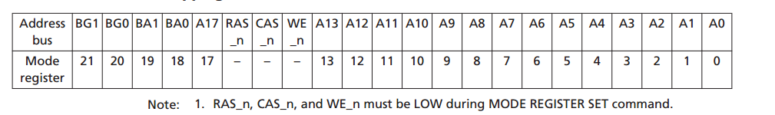
DRAM initialization

Slide 12
Write leveling
fly-by topology and has the benefits of reducing the number of stubs and their length.
The fly-by topology may cause skew between the clock and the data strobe. Write leveling is used to compensate for this skew by aligning the clock with the data strobe at each SDRAM.

Slide 13
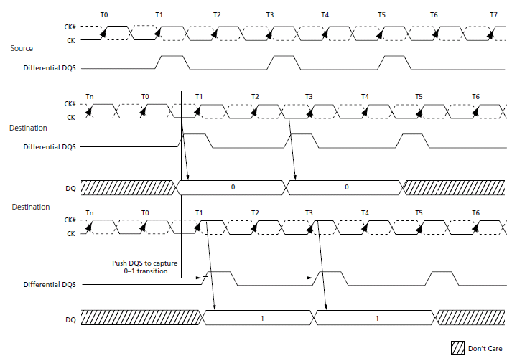
Write leveling

Slide 14

Read DQS Gating
Noise on a tri-stated DQS may generate false DQS edges. To prevent this from happening, the read data strobes are gated by the controller through the DQS slice so that they are active only during read cycles.
Precise alignment of the gate to the read data is a prerequisite for proper reads. Since delays, such as board trace lengths, in the read path are often imprecisely known, it is necessary to train the gate for a particular system.

Slide 15
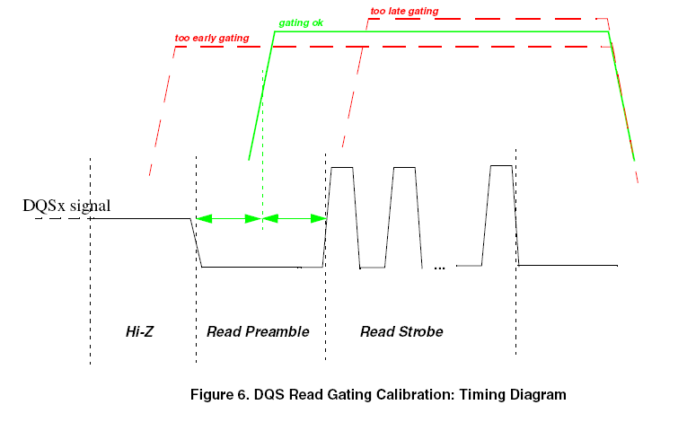
Read DQS Gating

Slide 16
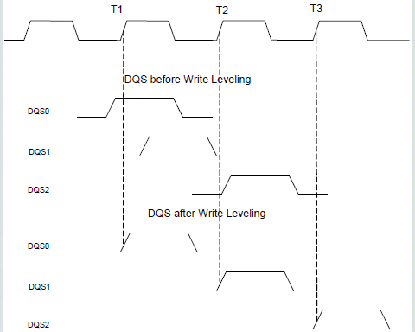
Write leveling 2
After write leveling training:

Slide 17
Read Bit De-skew
The goal of the PUB Read Bit De-skew training is to align a 0-to-1 transition on each of the data bits in the read path.

Slide 18
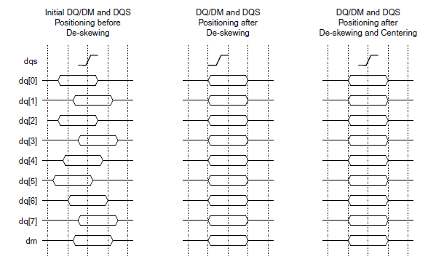
Read Bit De-skew

Slide 19
Write Bit De-skew
The goal of the PUB Write Bit De-skew algorithm is to align a 0-to-1 transition on each of the data bits and data mask in the write path.
The training sequence is the same as Read Bit De-Skew, excluding DM bit de-skew training.

Slide 20
Read & Write Eye Center
Touch the most-left edge and the most-right edge of data eyes.
And set the proper RDQS &WDQ LCDL ‘s value to make the DQS edge at the middle of data eyes.

Slide 21
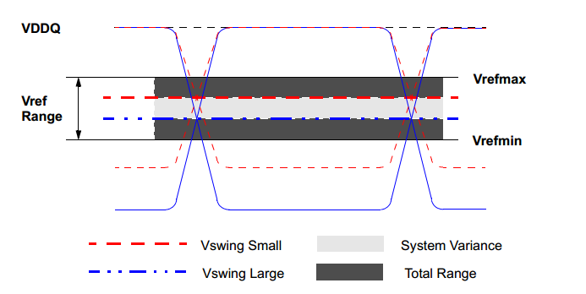
Vref Training
VREF training : determine a range of VREF values for which memory accesses are stable and then find the VREF value that results in the optimum write and read eye position.
DRAM VREF Training: optimize the write eye by sweeping DRAM VrefDQ values inside memory.
Host VREF Training: optimize the read eye by sweeping the PHY I/O’s VREF setting.

Slide 22
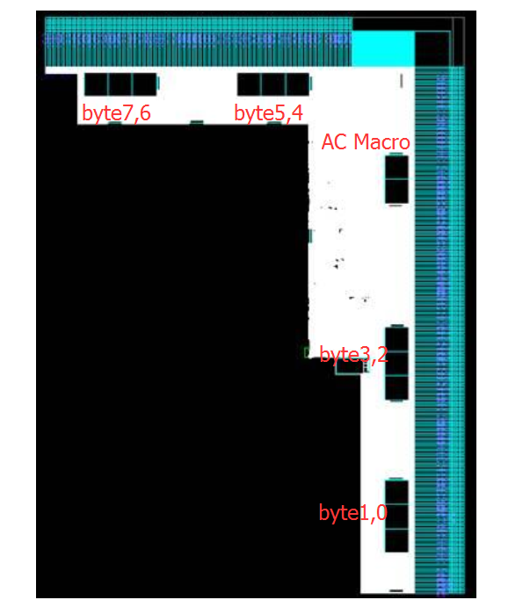
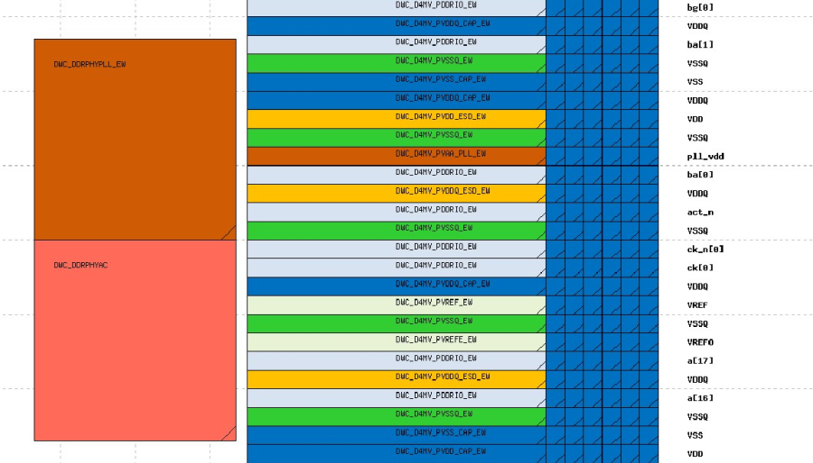
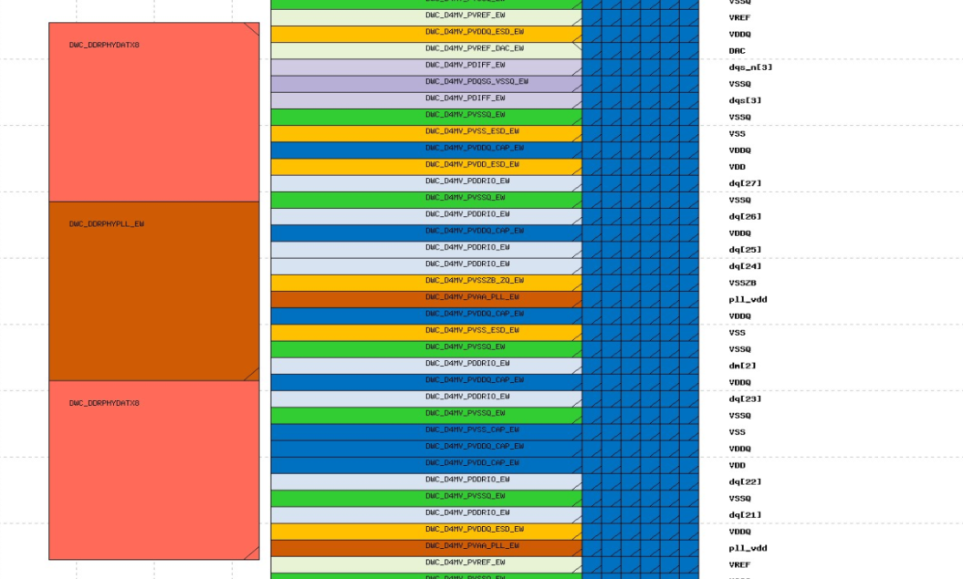
Appendix A
Backend layout –DDR part

Slide 23
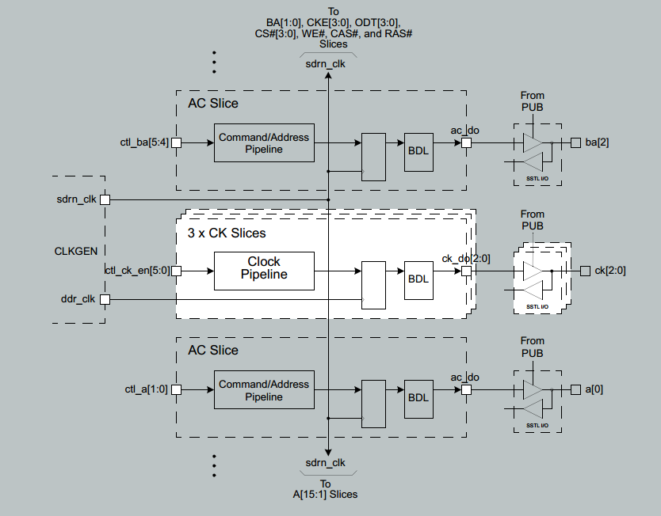
Appendix A
AC Command Path

Slide 24
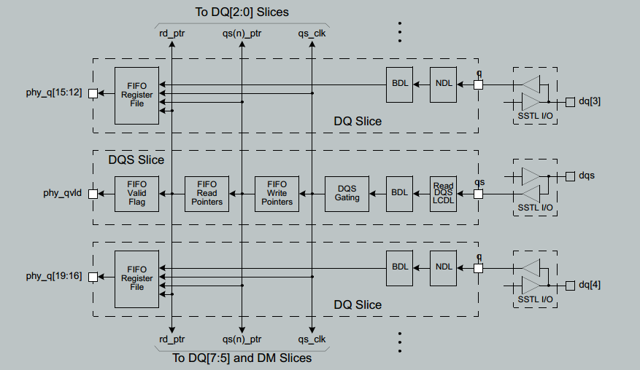
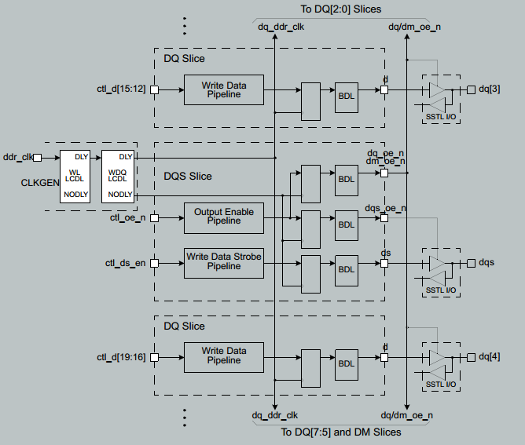
Appendix A
DATX8 Read & Write Data Path

Slide 25
Appendix B
Register | Description | Register | Description
tREFI | Average periodic refresh interval | tRC | ACT to ACT or REF command period
tMRD | Mode Register Set command cycle time | tRCD | ACT to internal read or write delay time
tRFC | REF command to ACT or REF command time | tRRD | ACT to ACT command period
tRP | PRE command period | tRTP | Internal READ Command to PRE Command delay
tRTW | Read to Write turnaround time | tWR | WRITE recovery time
tAL | Additive Latency | tWTR | Delay from start of internal write transaction to internal read command
tCL | CAS Latency | tEXSR | Exit Self Refresh to first valid command delay
tCWL | CAS Write Latency | tXP | Exit Power Down to first valid command delay when DLL is on (fast exit),
tRAS | ACT to PRE command period | tXPDLL | Exit Power Down to first valid command delay when DLL is off (slow exit)

